Slide 1
Ultimate design low noise microcomb amplifier
Questions
Problem with Isolator and high pump?
Why high inversion gives low noise?
Why a low inversion level yields high efficiency in the conversion of photons from pump to signal?
Why the inversion needs to be max at the input of the fiber for reducing the noise?
Why loss at the beginning of the fiber degrades the noise figure? Because input power is lower
Notes:
Why is ASE canceled or minimized in the middle? Because it is the point where the ASE backward is increasing and ASE forward is also increasing. Beyond this point, the total values of ASE is higher.

Slide 2





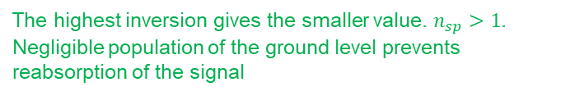
The highest inversion gives the smaller value. $n_{sp}>1$.
Negligible population of the ground level prevents reabsorption of the signal
Noise figure
$NF=\frac{SNR_{i}}{SNR_{o}}$ $SNR_{i}= \frac{I_{s}^{2}}{shot noise}$
$OSNR_{o} \sim \frac{{\left(G I \right)}^{2}}{Shot noise+(signal−ASE) noise}$ $OSNR_{i}= \frac{I_{s}^{2}}{shot noise}$
$NF=2 n_{sp}\frac{(G−1)}{G}+\frac{1}{G}+…$
Why do we want low noise at the beginning of the amplifier?
$SNR_{i}=\frac{S_{i}}{N_{i}}$
$SNR_{o}=\frac{S_{i}G_{1}G_{2}G_{3}}{N_{i}G_{1}G_{2}G_{3}+N_{A1}G_{2}G_{3}+N_{A2}G_{3 }+N_{A3}}$
$SNR_{o}=NF_{1}+ \frac{NF_{2}−1}{G_{1}}+\frac{NF_{3}−1}{G_{1}G_{2}}$
Increases with gain and low inversion.
It is reduced with high inversion
Noise output power in the bandwidth $Δν$ around the frequency $ν$ where the gain of the amplifier is G
The first amplifier has the most significant effect given the noise figures of the following stages are reduced by stage gains.
The first amplifier should have a low noise figure, and the noise figure requirements of subsequent stages can be more relaxed.
Notes:
Noise figure is determined primarly by the conditions at the input to the fiber.
Increasing the length of a short fiber increases the backwards ASE significantly, reducing the inversion level → Noise figure increases.

Slide 3
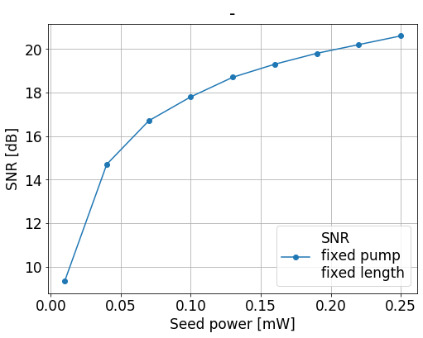
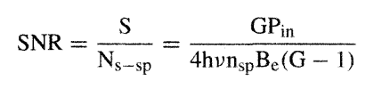
Saturation regime.
As the signal increases in power, the gain decreases since the pump cannot longer replenish the inversion as fast as the signal depletes it. (Depopulation of excited state due to an increasing number of signal photons)
Why saturation regime brings down ASE?
There is an interplace. In this regime, more seed does not have higher amplification but, also, there is a very few amount of residual inversion that ASE can catch up.
If the seed is weak, the ASE can collect a large amount of the inversion
Operation outside saturation allows more ions to be used for amplification (higher efficiency) but also, more ions are available for be taken by ASE (Higher noise)
Why SNR increases with input power?
More power is taken by the input signal and does not leave so much inversion available for ASE generation
Notes:
ASE starts with low power so it will not to go so high power levels. Your seed is rather high power level and it is already at the saturation. The seed collects most of the inversion such as there is nothing really left for the ASE to be built up in an efficient way. Because it is more powerful

Slide 4
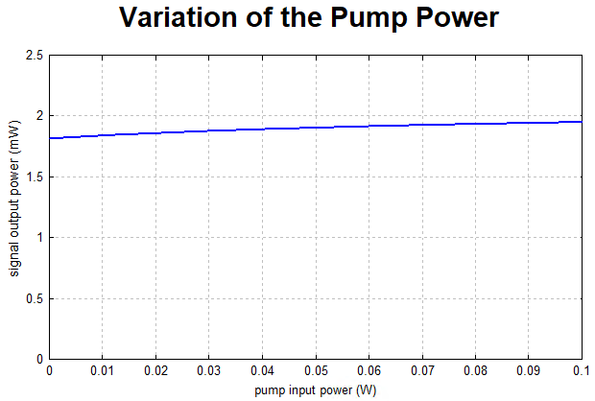
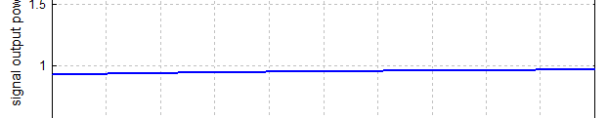
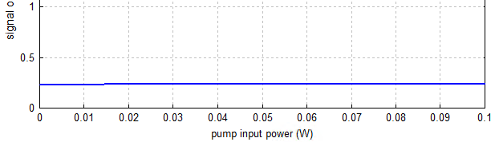
Why do we want a short fiber?
With a shorter fiber, the fiber can be well inverted across its entire length, thus offering a good noise figure.
However, a significant amount of pump light exits the fiber.
L = 2.5 m
L = 1.5 m
L = 0.5 m
Notes:
Low noise figures tipically require shorter lengths of fiber (to reduce the ASE) and high pump power, to achieve the same gain and maximize the inversion.

Slide 5

Why not operate with 5 dB/m gain fiber?
Case 1: We want to get a gain of 5 dB → We need therefore more than 3 m of fiber (When with 22 dB ~ 0.5 m)
Higher pump powers are now required at the input to invert the entire fiber, especially toward the end of the fiber.
Such amount of high power plus longer fiber generates a larger amount of ASE
Considering an inversion that remains constant throughout all fiber, the ASE increases exponentially with length.
With increasing ﬁber length, the values of generated noise will be increased due to the accumulation of previous noise
Case 2: Short fiber (0.5 m) of 5 dB/m gain. The output gain is less than 1 dB. Forcing the second amplifier to provide the rest needed gain.
Why not operate with 80 dB/m gain fiber?
Too much erbium can be too much of a good thing because of clustering and cooperative up-conversion quenching of the excited state. Clusters: two ions close together that only absorb and no emission → If one ion absorbs, it is excited, if the second is also excited they exchange energy and one of the ions is excited to a higher stage and the other one falls.

Slide 6
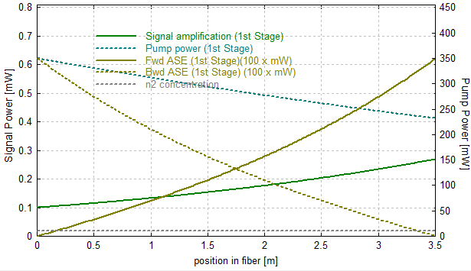
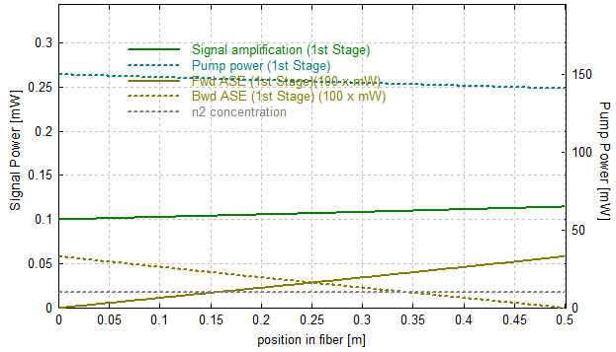
Why not operate with 5 dB/m gain fiber?
Case 1: Long fiber, higher gain Case 2: Short fiber, lower gain
ASE increases up to 6 µW for a 280 µW output power ASE is kept low but signal amplification reach less than 120 µW
Notes:
The inversion is actually lower at the beginnning of the fiber even though the 980 nm pump power is highest there, because the backward propagating ASE has reached ist highest power there and is significantly depleting the inversion.
Plus, backward ASE reduces takes inversion from the signal reducing the gain.

Slide 7
With all this in mind…
Multistage amplifier
ASE to be eliminated at the middle point along the fiber amplifier.
It is difficult to obtain simultaneously large gains and very low noise figures in a single stage amplifier.
By reducing the ASE, more gain is available for the signal and less noise is added to it from the spontaneous emission
The first stage needs to be well inverted so that a moderate amout of gain is obtained with minimal noise added.
PM isolator to be placed at the output of every stage to get rid of one polarization mode from ASE → reducition up to 50% the overall noise.
1st amplifier
Fiber length = Short fiber. To be optimized
Pumping power = Saturation regime
Pumping direction = Forward although given the short fiber might be irrelevant
Gain of active fiber = 22 dB/m
Gain ~ 5dB
2nd amplifier
Fiber = Longer fiber for higher gain. To be optimized
Pumping power = Outside small signal gain
Direction = Backward for higher efficiency and relaxed noise requirements
Gain of active fiber = 27 dB/m for higher gain
Gain > 15 dB

Slide 8
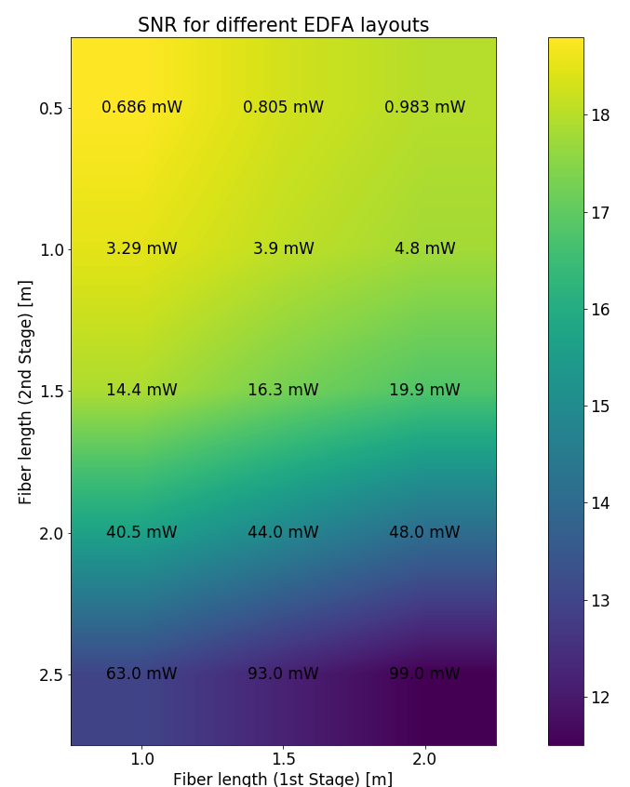
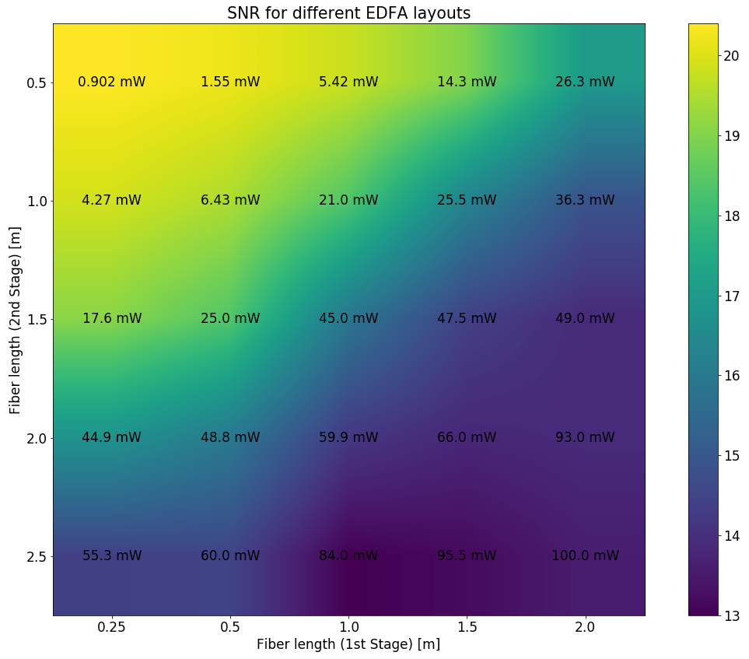
Optimization fiber amplifier stages
5 dB – 24 dB
24 dB – 27 dB
1.75 m:
SNR = 18.2 dB
30 mW

Slide 9
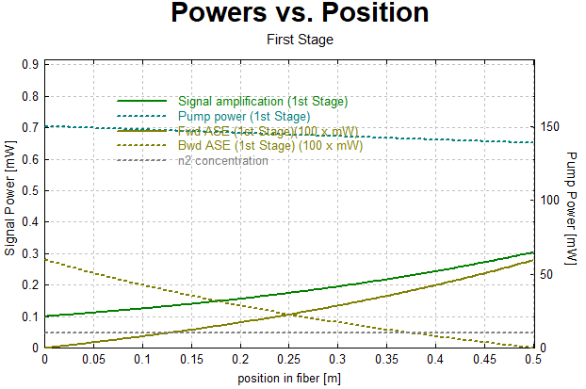
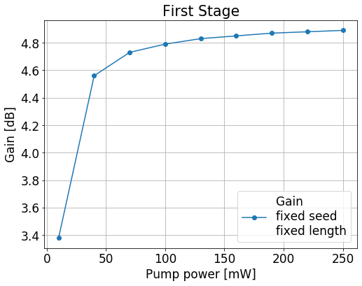
1st amplifier
Close to saturation regime. Low ASE but low efficiency.

Slide 10
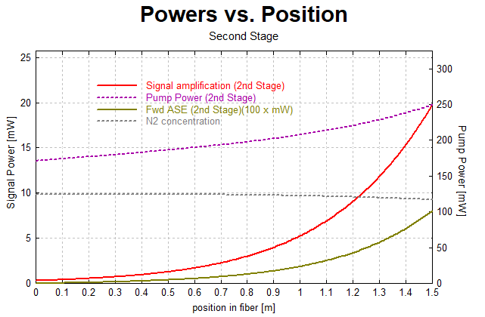
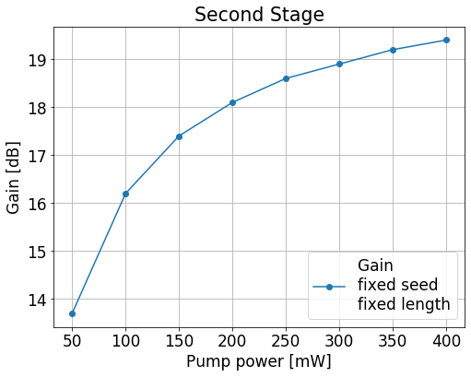
2nd amplifier
Outside saturation regime higher ASE but higher amplification.

Slide 11
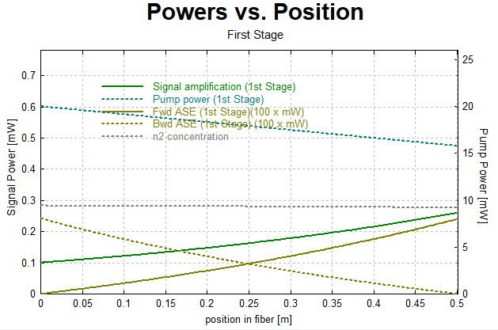
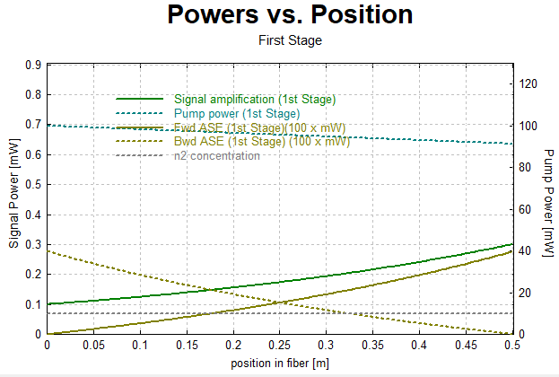
1st amplifier
20 mW
120 mW

Slide 12
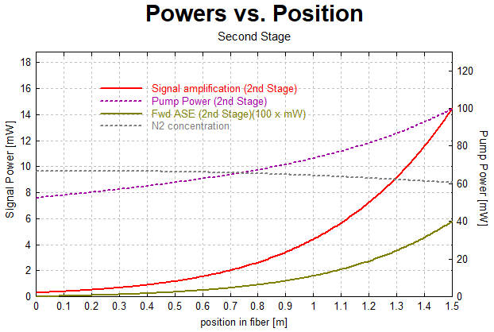
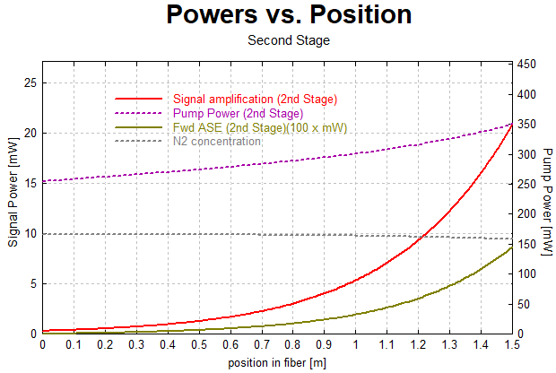
2nd amplifier
100 mW
350 mW

Slide 13
Backward and forward pumping configurations
LD Pump1
Pµmo
24 dB/m, Er3+
0.5 m
LD Pump2
fc/apc 980
Forward pumping
seed: output microcomb
ISO
WDM
ISO*
To input 2nd stage
27 dB/m, Er3+
1.9 m
Backward pumping
fc/apc 980
seed: output 1st stage
1550 fc/apc
WDM
ISO
1550 fc/apc

Slide 14
Final design
LD Pump1
Pµmo
24 dB/m, Er3+
0.5 m
LD Pump2
fc/apc 980
Forward pumping
seed: output microcomb
ISO
WDM
ISO*
To input 2nd stage
27 dB/m, Er3+
1.9 m
Backward pumping
fc/apc 980
seed: output 1st stage
1550 fc/apc
WDM
ISO
1550 fc/apc
*due to residual forward pump and backward pump from each amplifier respectively, this isolator might suffer some heat dissipation but, given the power values, should not be an issue.

Slide 15


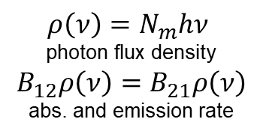
First, some definitions…
The highest inversion gives the smaller value. $n_{sp}>1$.
Negligible population of the ground level prevents reabsorption of the signal
Photon density in the mode $N_{m}$:
$ρ\left(ν\right)=N_{m}hν$
photon flux density
$$B_{12}ρ\left(ν\right)=B_{21}ρ\left(ν\right)$$
abs. and emission rate
Stim.
Abs.
ASE
ASE power evolution
across a fiber
Noise output power in the bandwidth $Δν$ around the frequency $ν$ where the gain of the amplifier is G
Increases with gain and low inversion.
It is reduced with high inversion
Notes:
Amplifiers operating on four-level transitions are generally assumed to provide quantum-limited noise performance because the negligible population of the terminal level prevents reabsorption of the signal.
Stimulated emission takes place only when the gain medium is pumped strongly enough and population inversion is created, while spontaneous emission takes place no matter population inversion exists or not.

Slide 16




About
x 2
.
if single mode fiber with two polarization modes
For getting the power, we compute the number of modes in the frequency band $Δν$ around the frequency $hν$

Slide 17
Copropagating and counterpropagating pumping
Counterpropagating pump is more efficient because the pump is strongest in the region where the signal is strongest.
Thus the signal can most efficiently deplete the inversion, as opposed to allowing the ASE to deplete the inversion
In the copropagating case, the backward ASE has benefited from the high pump powers at the input of the fiber, depleting the inversion and resulting in a backward ASE output that is higher than the signal output
Lowest noise in copropagating pump configuration
Cop: The portion of the fiber that the signal enteres tends to be more inverted than the section by which the signal exits.
Thus, the signal undergoes more gain per unit length at the beginning of the fiber than at the exit.
Countp: lower gain per unit length at the beginning of the fiber is equivalent to having some loss for the signal before it enters the amplifier.
Any loss that the signal experiences at the beginning of the fiber will degrade the noise figure.
For the optimization of the signal-to-noise ratio, the essential point is to keep the excitation density near the signal input as high as possible. That is actually achieved with forward (copropagating) pumping, where at the signal input we obtain a high pump power.
This argument is not as valid if the fiber is short enough; in that case, assuming that pump power is not limited, a strong enough pump will strongly invert the entire fiber and it will not matter whether the pump is copropagating or counterpropagating.
Notes:
To summarize, the most advantageous situation is to have the signal strong where the inversion is strong, so that the signal, not the ASE, will deplete the gain. The pump configuration that yields the highest conversion efficiency is bidirectional pumping. The resulting flattening of the upper-state population distribution results in an optimum situation with respect to the competition between signal and ASE. Bidirectional pumping yields a few dB more in gain (as compared to the counterpropagating pump) for moderate input powers in the —20 dBm range
As far as small signal gain is concerned, copropagating and counterpropagating pumps yeild the same gain and only the total amount of power matters. This is because the ASE patterns generated by the two pump patterns are mirror images of each other and so the average upper state population is the same in both cases.

